Slide 1
Lecture 4 : Data Types

Slide 2
Topics
Introduction
Primitive Data Types
Character String Types
Enumeration Types
Array Types
Associative Arrays
Record Types
Tuple Types
List Types
Union Types
Pointer and Reference Types
Type Checking

Slide 3
Introduction
A data type defines a collection of data objects and a set of predefined operations on those objects
A descriptor is the collection of the attributes of a variable
An object represents an instance of a user-defined (abstract data) type
One design issue for all data types: What operations are defined and how are they specified?

Slide 4
Primitive Data Types
Almost all programming languages provide a set of primitive data types
Primitive data types: Those not defined in terms of other data types
Some primitive data types are merely reflections of the hardware
Others require only a little non-hardware support for their implementation

Slide 5
Primitive Data Types: Integer
Almost always an exact reflection of the hardware so the mapping is trivial
There may be as many as eight different integer types in a language
Java’s signed integer sizes: byte, short, int, long

Slide 6
Primitive Data Types: Floating Point
Model real numbers, but only as approximations
Languages for scientific use support at least two floating-point types (e.g., float and double; sometimes more
Usually exactly like the hardware, but not always
IEEE Floating-Point
Standard 754

Slide 7
Primitive Data Types: Complex
Some languages support a complex type, e.g., C99, Fortran, and Python
Each value consists of two floats, the real part and the imaginary part
Literal form (in Python):
(7 + 3j), where 7 is the real part and 3 is the imaginary part

Slide 8
Primitive Data Types: Decimal
For business applications (money)
Essential to COBOL
C# offers a decimal data type
Store a fixed number of decimal digits, in coded form (BCD)
Advantage: accuracy
Disadvantages: limited range, wastes memory

Slide 9
Primitive Data Types: Boolean
Simplest of all
Range of values: two elements, one for “true” and one for “false”
Could be implemented as bits, but often as bytes
Advantage: readability

Slide 10
Primitive Data Types: Character
Stored as numeric codings
Most commonly used coding: ASCII
An alternative, 16-bit coding: Unicode (UCS-2)
Includes characters from most natural languages
Originally used in Java
C# and JavaScript also support Unicode
32-bit Unicode (UCS-4)
Supported by Fortran, starting with 2003

Slide 11
Character String Types
Values are sequences of characters
Design issues:
Is it a primitive type or just a special kind of array?
Should the length of strings be static or dynamic?

Slide 12
Character String Types Operations
Typical operations:
Assignment and copying
Comparison (=, >, etc.)
Catenation
Substring reference
Pattern matching

Slide 13
Character String Type in Certain Languages
C and C++
Not primitive
Use char arrays and a library of functions that provide operations
SNOBOL4 (a string manipulation language)
Primitive
Many operations, including elaborate pattern matching
Fortran and Python
Primitive type with assignment and several operations
Java
Primitive via the String class
Perl, JavaScript, Ruby, and PHP
- Provide built-in pattern matching, using regular
expressions

Slide 14
Character String Length Options
Static: COBOL, Java’s String class
Limited Dynamic Length: C and C++
In these languages, a special character is used to indicate the end of a string’s characters, rather than maintaining the length
Dynamic (no maximum): SNOBOL4, Perl, JavaScript

Slide 15
Character String Implementation
Static length: compile-time descriptor
Limited dynamic length: may need a run-time descriptor for length (but not in C and C++)
Dynamic length: need run-time descriptor; allocation/deallocation is the biggest implementation problem

Slide 16
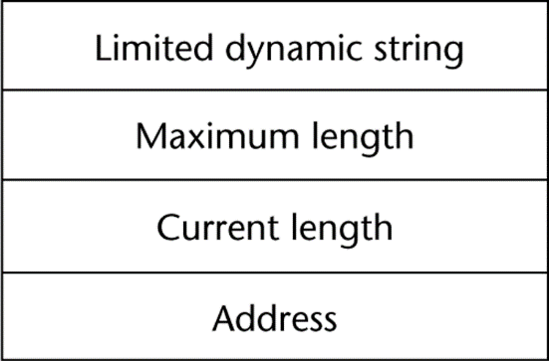
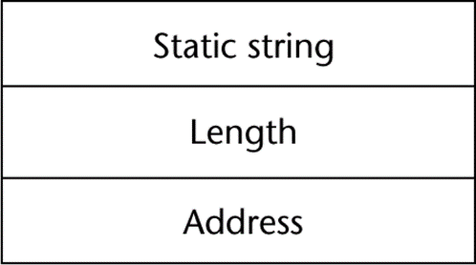
Compile- and Run-Time Descriptors
Compile-time descriptor for static strings
Run-time descriptor for limited dynamic strings

Slide 17
User-Defined Ordinal Types
An ordinal type is one in which the range of possible values can be easily associated with the set of positive integers
Examples of primitive ordinal types in Java
integer
char
boolean

Slide 18
Enumeration Types
All possible values, which are named constants, are provided in the definition
C# example
enum days {mon, tue, wed, thu, fri, sat, sun};
Design issues
Is an enumeration constant allowed to appear in more than one type definition, and if so, how is the type of an occurrence of that constant checked?
Are enumeration values coerced to integer?
Any other type coerced to an enumeration type?

Slide 19
Evaluation of Enumerated Type
Aid to readability, e.g., no need to code a color as a number
Aid to reliability, e.g., compiler can check:
operations (don’t allow colors to be added)
No enumeration variable can be assigned a value outside its defined range
C# and Java 5.0 provide better support for enumeration than C++ because enumeration type variables in these languages are not coerced into integer types

Slide 20
Array Types
An array is a homogeneous aggregate of data elements in which an individual element is identified by its position in the aggregate, relative to the first element.

Slide 21
Array Indexing
Indexing (or subscripting) is a mapping from indices to elements
array_name (index_value_list) → an element
Index Syntax
Fortran and Ada use parentheses
Ada explicitly uses parentheses to show uniformity between array references and function calls because both are mappings
Most other languages use brackets

Slide 22
Arrays Index (Subscript) Types
FORTRAN, C: integer only
Java: integer types only
Index range checking
- C, C++, Perl, and Fortran do not specify
range checking
- Java, ML, C# specify range checking

Slide 23
Array Initialization
Some language allow initialization at the time of storage allocation
C, C++, Java, C# example
int list [] = {4, 5, 7, 83}
Character strings in C and C++
char name [] = ″freddie″;
Arrays of strings in C and C++
char *names [] = {″Bob″, ″Jake″, ″Joe″];
Java initialization of String objects
String[] names = {″Bob″, ″Jake″, ″Joe″};

Slide 24
Heterogeneous Arrays
A heterogeneous array is one in which the elements need not be of the same type
Supported by Perl, Python, JavaScript, and Ruby

Slide 25
Array Initialization
C-based languages
int list [] = {1, 3, 5, 7}
char *names [] = {″Mike″, ″Fred″, ″Mary Lou″};
Python
List comprehensions
list = [x ** 2 for x in range(12) if x % 3 == 0]
puts [0, 9, 36, 81] in list

Slide 26
Arrays Operations
APL provides the most powerful array processing operations for vectors and matrixes as well as unary operators (for example, to reverse column elements)
Python’s array assignments, but they are only reference changes. Python also supports array catenation and element membership operations
Ruby also provides array catenation

Slide 27
Rectangular and Jagged Arrays
A rectangular array is a multi-dimensioned array in which all of the rows have the same number of elements and all columns have the same number of elements
A jagged matrix has rows with varying number of elements
Possible when multi-dimensioned arrays actually appear as arrays of arrays
C, C++, and Java support jagged arrays
F# and C# support rectangular arrays and jagged arrays

Slide 28
Slices
A slice is some substructure of an array; nothing more than a referencing mechanism
Slices are only useful in languages that have array operations

Slide 29
Slice Examples
Python
vector = [2, 4, 6, 8, 10, 12, 14, 16]
mat = [[1, 2, 3], [4, 5, 6], [7, 8, 9]]
vector (3:6) is a three-element array
mat[0][0:2] is the first and second element of the first row of mat
Ruby supports slices with the slice method
list.slice(2, 2) returns the third and fourth elements of list

Slide 30
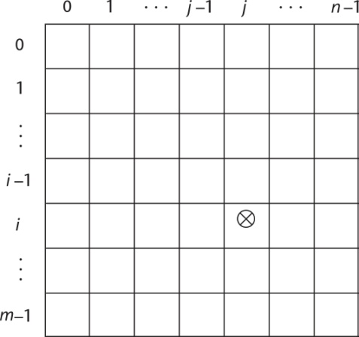
Implementation of Arrays
Access function maps subscript expressions to an address in the array
Access function for single-dimensioned arrays:
address(list[k]) = address (list[lower_bound])
+ ((k-lower_bound) * element_size)

Slide 31
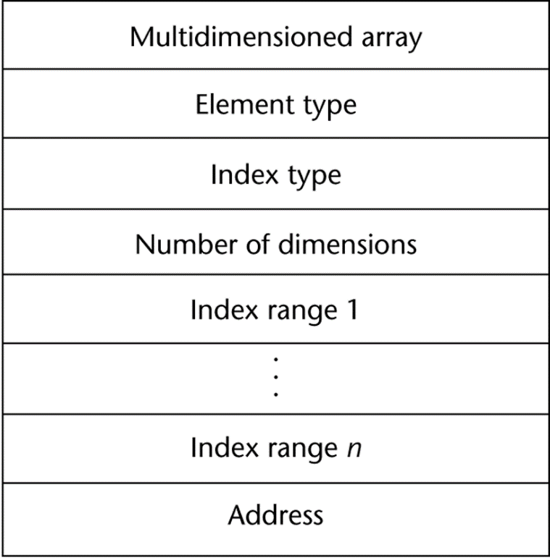
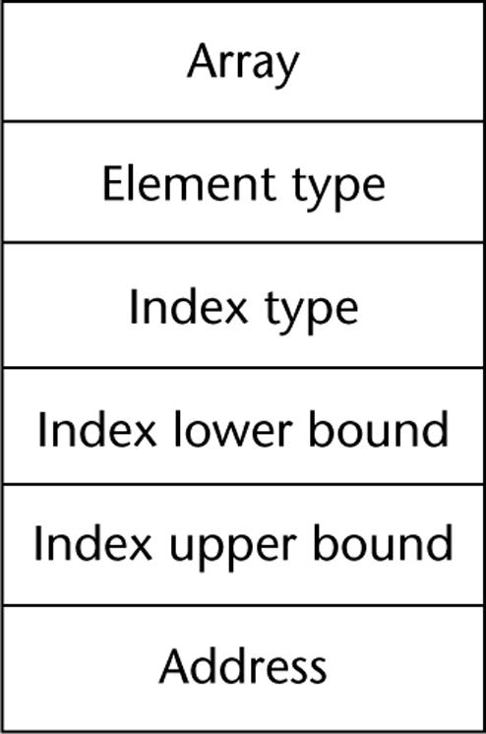
Compile-Time Descriptors
Single-dimensioned array
Multidimensional array

Slide 32
Record Types
A record is a possibly heterogeneous aggregate of data elements in which the individual elements are identified by names
Design issues:
What is the syntactic form of references to the field?
Are elliptical references allowed

Slide 33
Evaluation and Comparison to Arrays
Records are used when collection of data values is heterogeneous
Access to array elements is much slower than access to record fields, because subscripts are dynamic (field names are static)
Dynamic subscripts could be used with record field access, but it would disallow type checking and it would be much slower

Slide 34
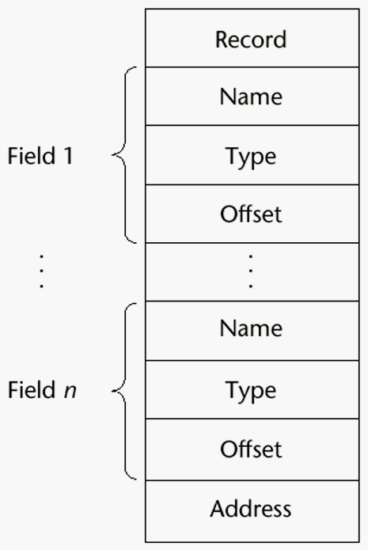
Implementation of Record Type
Offset address relative to the beginning of the records is associated with each field

Slide 35
Tuple Types
A tuple is a data type that is similar to a record, except that the elements are not named
Used in Python, ML, and F# to allow functions to return multiple values
Python
Closely related to its lists, but immutable
Create with a tuple literal
myTuple = (3, 5.8, ′apple′)
Referenced with subscripts (begin at 1)
Catenation with + and deleted with del

Slide 36
Tuple Types (continued)
ML
val myTuple = (3, 5.8, ′apple′);
- Access as follows:
#1(myTuple) is the first element
- A new tuple type can be defined
type intReal = int * real;
F#
let tup = (3, 5, 7)
let a, b, c = tup This assigns a tuple to a tuple pattern (a, b, c)

Slide 37
List Types
Lists in Lisp and Scheme are delimited by parentheses and use no commas
(A B C D) and (A (B C) D)
Data and code have the same form
As data, (A B C) is literally what it is
As code, (A B C) is the function A applied to the
parameters B and C
The interpreter needs to know which a list is, so if it is data, we quote it with an apostrophe
′(A B C) is data

Slide 38
List Types (continued)
List Operations in Scheme
CAR returns the first element of its list parameter
(CAR ′(A B C)) returns A
CDR returns the remainder of its list parameter after the first element has been removed
(CDR ′(A B C)) returns (B C)
- CONS puts its first parameter into its second parameter, a list, to make a new list
(CONS ′A (B C)) returns (A B C)
LIST returns a new list of its parameters
(LIST ′A ′B ′(C D)) returns (A B (C D))

Slide 39
List Types (continued)
List Operations in ML
Lists are written in brackets and the elements are separated by commas
List elements must be of the same type
The Scheme CONS function is a binary operator in ML, ::
3 :: [5, 7, 9] evaluates to [3, 5, 7, 9]
The Scheme CAR and CDR functions are named hd and tl, respectively

Slide 40
List Types (continued)
F# Lists
Like those of ML, except elements are separated by semicolons and hd and tl are methods of the List class
Python Lists
The list data type also serves as Python’s arrays
Unlike Scheme, Common Lisp, ML, and F#, Python’s lists are mutable
Elements can be of any type
Create a list with an assignment
myList = [3, 5.8, "grape"]

Slide 41
Unions Types
A union is a type whose variables are allowed to store different type values at different times during execution
Design issue
Should type checking be required?

Slide 42
Discriminated vs. Free Unions
C and C++ provide union constructs in which there is no language support for type checking; the union in these languages is called free union
Type checking of unions require that each union include a type indicator called a discriminant
Supported by ML, Haskell, and F#

Slide 43
Evaluation of Unions
Free unions are unsafe
Do not allow type checking
Java and C# do not support unions
Reflective of growing concerns for safety in programming language

Slide 44
Pointer Operations
Two fundamental operations: assignment and dereferencing
Assignment is used to set a pointer variable’s value to some useful address
Dereferencing yields the value stored at the location represented by the pointer’s value
Dereferencing can be explicit or implicit
C++ uses an explicit operation via *
j = *ptr
sets j to the value located at ptr

Slide 45
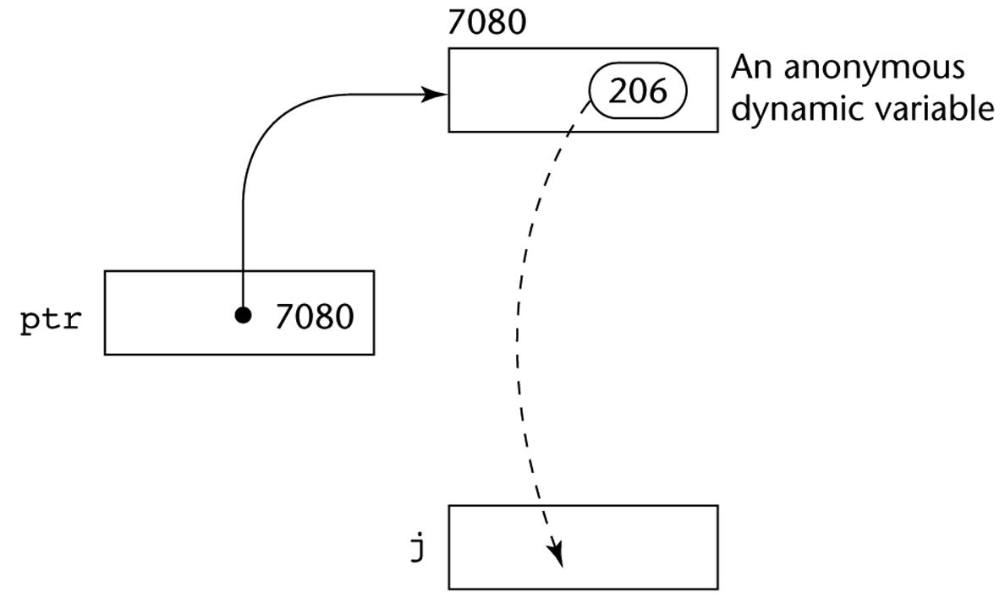
Pointer Assignment Illustrated
The assignment operation j = *ptr

Slide 46
Problems with Pointers
Dangling pointers (dangerous)
A pointer points to a heap-dynamic variable that has been deallocated
Lost heap-dynamic variable
An allocated heap-dynamic variable that is no longer accessible to the user program (often called garbage)
Pointer p1 is set to point to a newly created heap-dynamic variable
Pointer p1 is later set to point to another newly created heap-dynamic variable
The process of losing heap-dynamic variables is called memory leakage

Slide 47
Reference Types
C++ includes a special kind of pointer type called a reference type that is used primarily for formal parameters
Advantages of both pass-by-reference and pass-by-value
Java extends C++’s reference variables and allows them to replace pointers entirely
References are references to objects, rather than being addresses
C# includes both the references of Java and the pointers of C++

Slide 48
Evaluation of Pointers
Dangling pointers and dangling objects are problems as is heap management
Pointers are like goto's--they widen the range of cells that can be accessed by a variable
Pointers or references are necessary for dynamic data structures--so we can't design a language without them

Slide 49
Representations of Pointers
Large computers use single values
Intel microprocessors use segment and offset

Slide 50
Dangling Pointer Problem
Tombstone: extra heap cell that is a pointer to the heap-dynamic variable
The actual pointer variable points only at tombstones
When heap-dynamic variable de-allocated, tombstone remains but set to nil
Costly in time and space
. Locks-and-keys: Pointer values are represented as (key, address) pairs
Heap-dynamic variables are represented as variable plus cell for integer lock value
When heap-dynamic variable allocated, lock value is created and placed in lock cell and key cell of pointer

Slide 51
Heap Management
A very complex run-time process
Single-size cells vs. variable-size cells
Two approaches to reclaim garbage
Reference counters (eager approach): reclamation is gradual
Mark-sweep (lazy approach): reclamation occurs when the list of variable space becomes empty

Slide 52
Reference Counter
Reference counters: maintain a counter in every cell that store the number of pointers currently pointing at the cell
Disadvantages: space required, execution time required, complications for cells connected circularly
Advantage: it is intrinsically incremental, so significant delays in the application execution are avoided

Slide 53
Variable-Size Cells
All the difficulties of single-size cells plus more
Required by most programming languages
If mark-sweep is used, additional problems occur
The initial setting of the indicators of all cells in the heap is difficult
The marking process in nontrivial
Maintaining the list of available space is another source of overhead

Slide 54
Type Checking
Generalize the concept of operands and operators to include subprograms and assignments
Type checking is the activity of ensuring that the operands of an operator are of compatible types
A compatible type is one that is either legal for the operator, or is allowed under language rules to be implicitly converted, by compiler- generated code, to a legal type
This automatic conversion is called a coercion.
A type error is the application of an operator to an operand of an inappropriate type

Slide 55
Type Checking (continued)
If all type bindings are static, nearly all type checking can be static
If type bindings are dynamic, type checking must be dynamic
A programming language is strongly typed if type errors are always detected
Advantage of strong typing: allows the detection of the misuses of variables that result in type errors

Slide 56
Summary
The data types of a language are a large part of what determines that language’s style and usefulness
The primitive data types of most imperative languages include numeric, character, and Boolean types
The user-defined enumeration and subrange types are convenient and add to the readability and reliability of programs
Arrays and records are included in most languages
Pointers are used for addressing flexibility and to control dynamic storage management

